Slide 1
Chapter-5
Evaluation Metrics for supervised learning

Slide 2
Introduction
Evaluation aims at selecting the most appropriate learning schema for a specific problem
We evaluate its ability to generalize what it has been learned from the training set on the new unseen instances
Comparison of multiple classifiers on a specific domain (e.g. to find the best algorithm for a given application task)

Slide 3
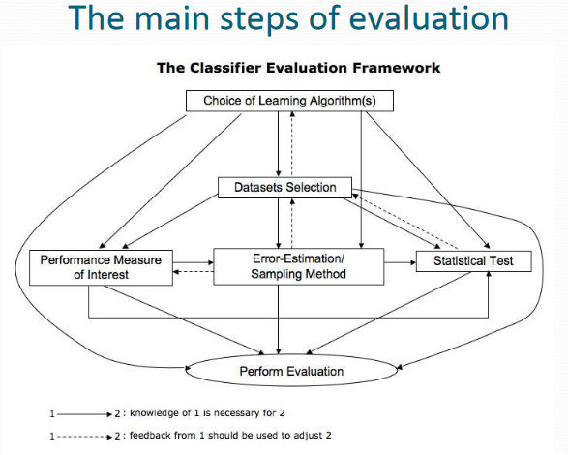

Slide 4


Absolute and Mean Square Error
  Refers to the error committed to classify an object to the desired class
  Error is defined as the difference between the desired value and the predicted value
  Absolute mean square error is the sum of absolute value of the errors for all the test data set
  Mean square error is defined as
where e_{i} = desired – predicted value

Slide 5
Accuracy
It assumes equal cost for all classes
Misleading in unbalanced datasets
It doesn’t differentiate between different types of errors
Ex 1:
  Cancer Dataset: 10000 instances, 9990 are normal, 10 are ill , If our model classified all instances as normal accuracy will be 99.9 %
  Medical diagnosis: 95 % healthy, 5% disease.
  e-Commerce: 99 % do not buy, 1 % buy.
  Security: 99.999 % of citizens are not terrorists.

Slide 6
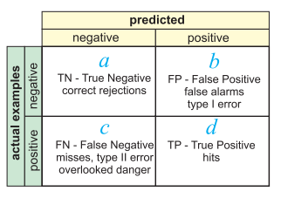
Binary classification Confusion Matrix

Slide 7



Binary classification Confusion Matrix
True Positive Rate
False Positive Rate
Overall success rate (Accuracy)
Error rate =1- success rate

Slide 8


Sensitivity & Specificity
Sensitivity
  Measures the classifier ability to detect positive classes (its positivity)
Specificity
  The specificity measures how accurate is the classifier in not detecting too many false positives (it measures its negativity)
  high specificity are used to confirm the results of sensitive
Notes:
A very sensitive classifier will find a number of false positives, but no true positives will be missed , the calculated number measures the classifier ability to detect positive classes (its positivity)
The maximum value for sensitivity is 1 (very sensitive classifier) and the minimum is 0 (the classifier never predicts positive values)
--
The specificity measures how accurate is the classifier in not detecting too many false positives, it is calculated by finding the percentage of true negatives from all negative instances (it measures its negativity)
The maximum value for Specificity is 1 (very specific ,no false positives) and the minimum is 0 ( means that it classifies everything is positive )
high specificity are used to confirm the results of sensitive

Slide 9
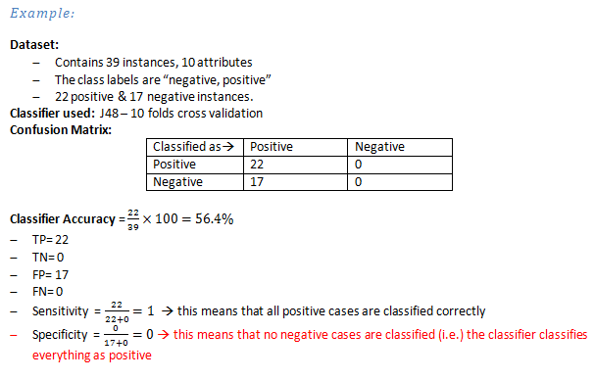

Slide 10
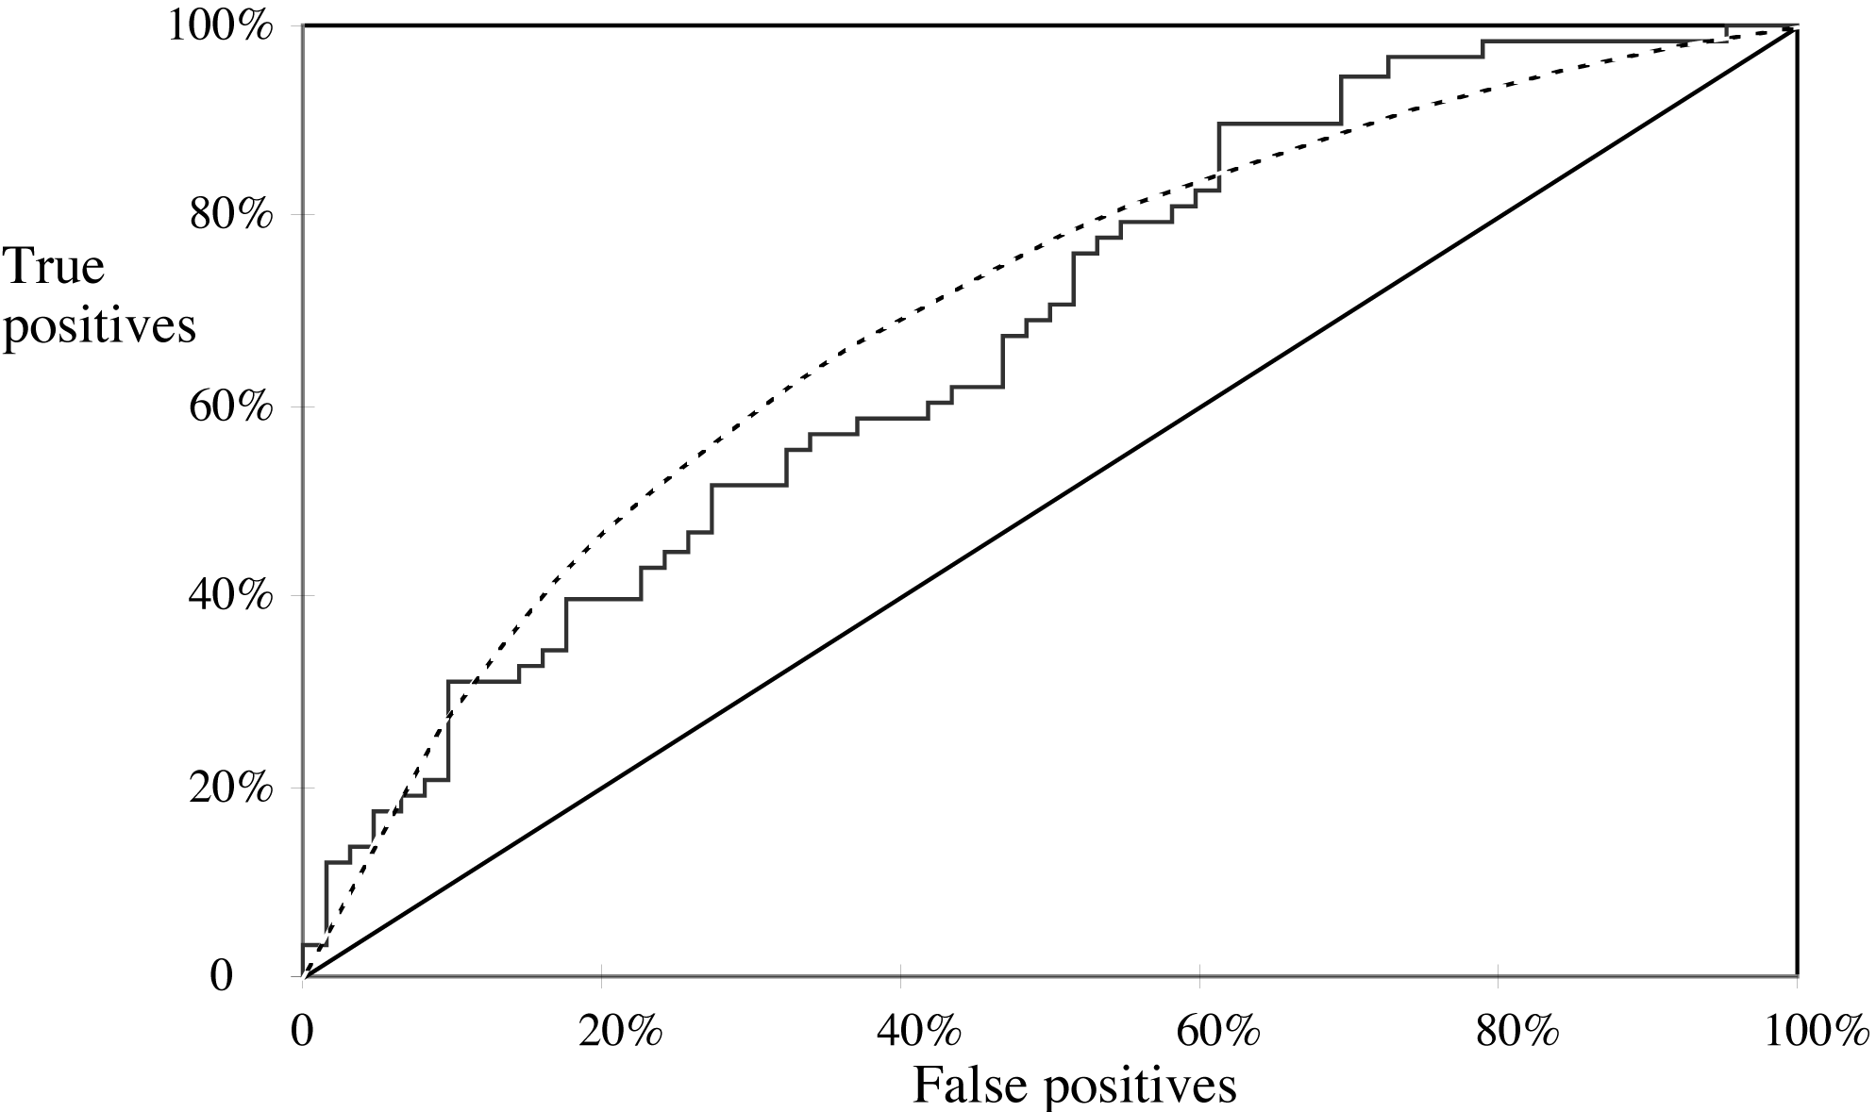
ROC Curves
Stands for “receiver operating characteristic”
Used in signal detection to show trade off between hit rate and false alarm rate over noisy channel
Jagged curve—one set of test data
Smooth curve—use cross-validation
Notes:
y axis shows percentage of true positives in sample
x axis shows percentage of false positives in sample

Slide 11
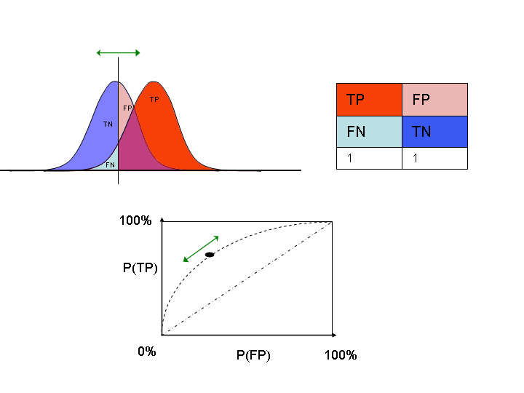
moving threshold
class 0 (negatives)
class 1 (positives)
Identify a threshold in
your classifier that you
can shift.
Plot ROC curve while you
shift that parameter.

Slide 12
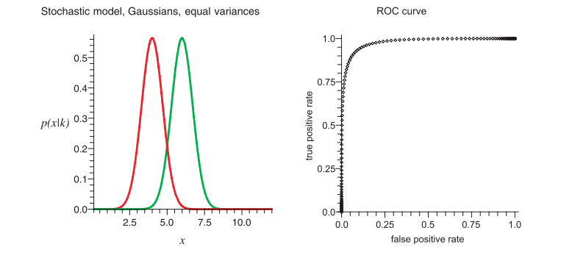

Slide 13
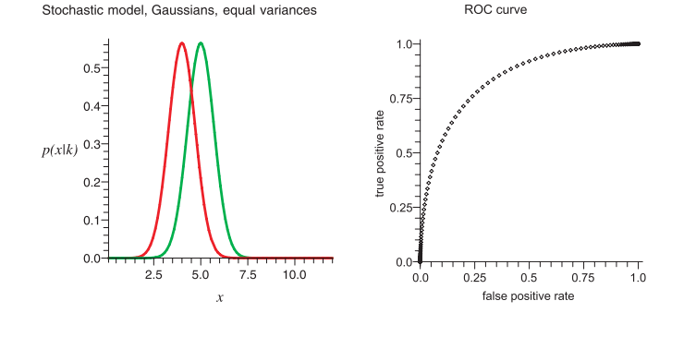

Slide 14
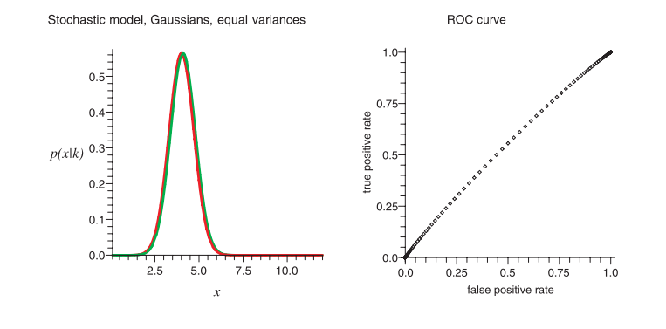

Slide 15
ROC curve
Accuracy is measured by the area under the ROC curve. (AUC) An area of 1 represents a perfect test; an area of .5 represents a worthless test:
  .90-1 = excellent
  .80-.90 = good
  .70-.80 = fair
  .60-.70 = poor
  .50-.60 = fail

Slide 16
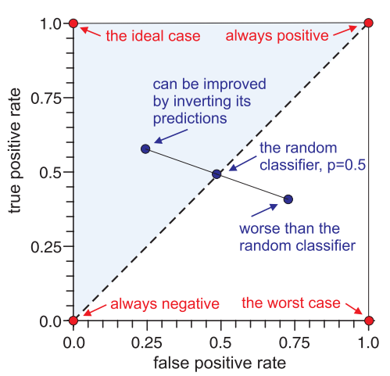
ROC curve characteristics

Slide 17


Recall & Precision
It is used by information retrieval researches to measure accuracy of a search engine, they define the recall as (number of relevant documents retrieved) divided by ( total number of relevant documents)
Recall (also called Sensitivity in some fields) measures the proportion of actual positives which are correctly identified as such (e.g. the percentage of sick people who are identified as having the condition);
Precession of class Yes in classification can defined as the number of instance classified correctly as class Yes divided by the total number of instances classified as Yes by the classifier

Slide 18
F-measure
The F-measure is the harmonic-mean (average of rates) of precision and recall and takes account of both measures.
It is biased towards all cases except the true negatives

Slide 19
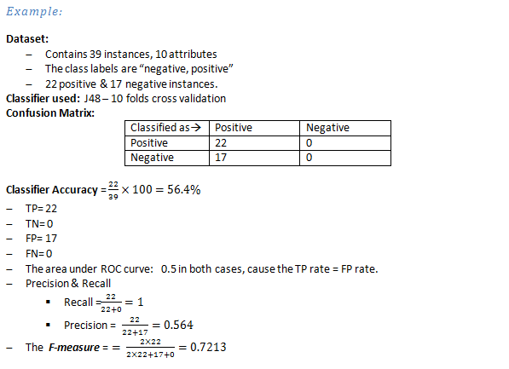

Slide 20
Notes on Metrics
As we can see the True Positive rate = Recall = Sensitivity all are measuring how good the classifier is in finding true positives.
When FP rate increases, specificity & precision decreases & vice verse,
It doesn't mean that specificity and precision are correlated,
  for example in unbalanced datasets the precision can be very low where the specificity is high
  cause the number of instances in the negative class is much higher than the number of positive instances

Slide 21
Multiclass classification
For Multiclass prediction task, the result is usually displayed in confusion matrix where there is a row and a column for each class,
  Each matrix element shows the number of test instances for which the actual class is the row and the predicted class is the column
  Good results correspond to large numbers down the diagonal and small values (ideally zero) in the rest of the matrix
Classified as | a | b | c
A | TP_{aa} | FN_{ab} | FN_{ac}
B | FP_{ab} | TN_{bb} | FN_{bc}
C | FP_{ac} | FN_{cb} | TN_{cc}

Slide 22
Multiclass classification
For example in three classes task {a , b , c} with the confusion matrix below, if we selected a to be the class of interest then
Note that we don’t care about the values (FNcb & FNbc) as we are considered with evaluating how the classifier is performing with class a, so the misclassifications between the other classes is out of our interest.

Slide 23
Multiclass classification
To calculate overall model performance, we take their weighted average to evaluate the overall performance of the classifier.
Averaged per category (macro average) :
  Gives equal weight to each class, including rare ones

Slide 24


Multiclass classification
Micro Average:
  Obtained from true positives (TP), false positives (FP), and false negatives (FN) for each class, and F-measure is the harmonic mean of micro-averaged precision and recall
  Micro average gives equal weight to each sample regardless of its class.
  They are dominated by those classes with the large number of samples.

Slide 25
Practical Implementation
Implement K-fold cross-validation
Machine Learning algorithms
Evaluation metrics

